Slide 1


Go, change the world
RV College of
Engineering
Design Thinking
Department of CSE
Phase I

Slide 2

Go, change the world
RV College of
Engineering
Team Details
Team Members
Nachiket G Kallapur
Vishal M
Dave Shivangi Devendra
Pavankumar V Badiger
Mentors
Prof. Pavithra H and Prof. Prafulla S B

Slide 3
Go, change the world
RV College of
Engineering
Team Members Responsibility
Nachiket and Vishal had to interview of farmers from Shimoga, Davangere, Udupi and Hassan which represent different agricultural zones in Karnataka.
Pavankumar and Shivangi had to take up survey of farmers living in remote areas via google form and prepare an analytical model for the same keeping in mind the data collected from audio interviews and google forms.

Slide 4

Go, change the world
RV College of
Engineering
Empathy
Questionnaire
Cultivation techniques
What are the crops grown?
What is the source of water of cultivation?
Is soil testing done before sowing seeds?
Is organic farming practiced?
Are smart farming methods and advanced technological equipment used?
Is Crop Rotation followed?
Does the farmer follow multi-cropping?

Slide 5
RV College of
Engineering
Empathy
Go, change the world
Questionnaire contd.
Factors affecting yield and income
Is sudden changes in climate leading to losses?
Is unavailability of good quality seeds leading to poor yield?
Is the poor yield because of improper planning?
Is government providing climate analysis to the farmers?
Is the farmer consulting any expert to improve his yield and profits?
Are the farmers exposed to price variations in the market?
What is the Producer’s share in consumer Rupee?

Slide 6
Go, change the world
RV College of
Engineering
Empathy
Sample client details
Name: Malatesh
Age: 52
Location of farm: Sakaleshpur
Land area: 10 acres
Crops grown: Coffee, Cardamom
Modern Techniques Implemented: Organic farming, Soil testing
Modern Equipment used: N.A
Profit percentage: 30%

Slide 7

Go, change the world
RV College of
Engineering
Empathy- Evidences
Sample evidences- Videos/Images/Audio

Slide 8
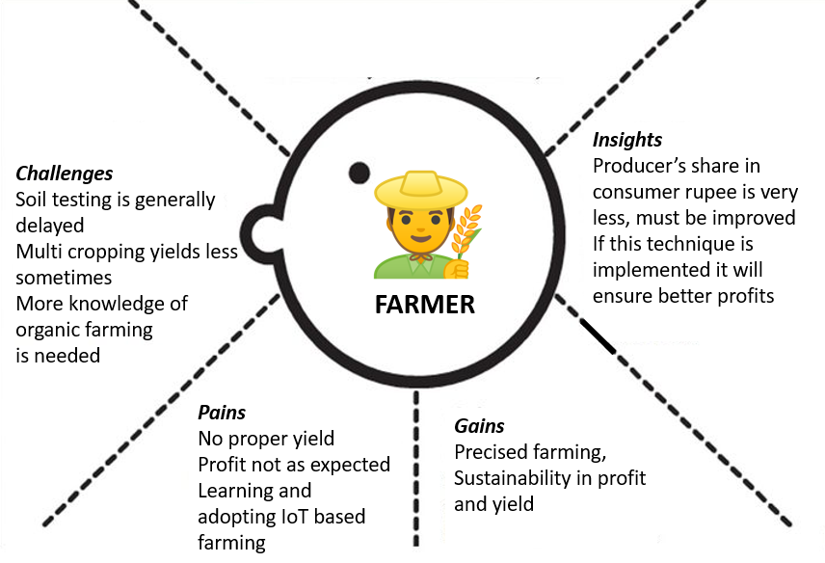
Go, change the world
RV College of
Engineering
Empathy Map

Slide 9
RV College of
Engineering
Empathy: Data Analytics
Go, change the world
Consider a black soil region where crops like wheat(monocot), grams(dicot) can be grown. A man has 10 hectare land where he can grow either of them or both of them in some proportion(say x:y). Let us assume that if the soil fertility is 100% there is an yield of 4 tons of wheat per hectare. Growing only wheat reduces the fertility of soil by 10% every year.
Next slide shows the analysis of farmers revenue for growth of wheat.

Slide 10
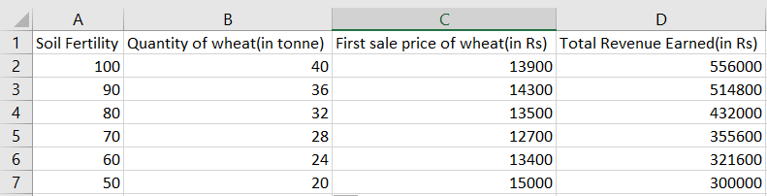
RV College of
Engineering
Empathy:Data Analytics
Go, change the world

Slide 11
RV College of
Engineering
Empathy:Data Analytics
Go, change the world
Another farmer of same region grows 3:2 proportion of wheat and Bengal gram. Bengal gram is a dicot, deep rooted crop which fixes atmospheric nitrogen in to soil. This would maintain nitrogen content in the soil. Now, say the remaining nutrients contributing to fertility reduce by 3% a year.(100% soil fertility would yield 2 ton of Bengal gram per hectare)
Next slide shows the revenue analysis of this farmer.

Slide 12
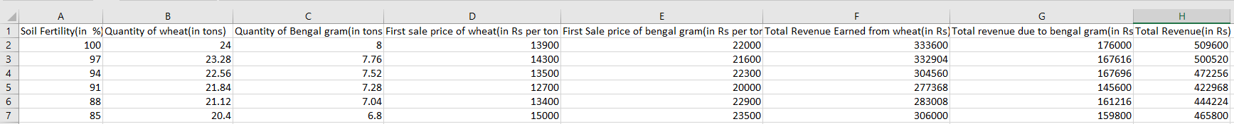
RV College of
Engineering
Empathy:Data Analytics
Go, change the world

Slide 13
Go, change the world
Problem Statement: Increase farm yield, secure and standardize farmer’s life
Subtheme:
The world is drastically changing with the advent of AI and smart devices. Agriculture, the backbone for Indian economy has went through an era of deprived security leading to subtle farming. With the increasing effects on nature as a result of industrialization, global warming and population explosion, it is our responsibility to integrate technology in addressing these scenarios. As engineering students and technology optimists, we came up with integrating machine learning with agricultural IOT with an intention of improving resource utilization , cost optimization and recommender system for maximum yield prediction. We feel the incidence of AI in almost all the domains is evident by the next 25 years, so we aspire to come up with an approach to address the same in an eco-friendly and robust way with an intention of improving precision agriculture.
RV College of
Engineering
Problem Statement and Subtheme

Slide 14
Go, change the world
Machine Learning in Agricultural IoT
RV College of
Engineering
Title

Slide 15
Go, change the world
RV College of
Engineering
Prototyping Tools and Technologies
To prototype our model, we will need the following:
Sensors which would be useful in agricultural IOT like Temperature and humidity sensor, water level sensors, irrigation monitoring sensor etc which are needed for creating datasets.
Microcontroller with ESP8266 module like NODE MCU for creating a Local host as it is cost effective compared to Rasperry PI.
A cloud platform to analyse the real time data and make smart prediction for real time monitoring and resource utilization.
A machine learning model constraint to n(yet to be decided) parameters to create our probabilistic model.
A server coupled with a scalable database as we need to have zonal data partitioned and provide zone specific recommendation for the farmer.

Slide 16
Go, change the world
RV College of
Engineering
Expected Outcome
The expected outcomes of our DTL project are as follows:
Create a self sustained agricultural model which can address the various agricultural problems with respect to resource utilization, cost optimization and real time monitoring.
Create a probabilistic model based on five year data collection zonally and create a recommender system for the farmers to improve their yield in worst case scenarios.
Improve the concept of crop rotation and multi cropping through our prototype as we found this to be the problem faced by the farmers via surveying them.
Making agricultural IOT cost effective by reducing the cost on the hardware components(Using NODE MCU instead of Rasperry PI which is 10 times cheaper) and to have a centralized approach for monitoring gross field monitoring.
Making this platform as simple and reachable to the rural farmers who are not so used to technology.

Slide 17
Go, change the world
RV College of
Engineering
References
U.B Sangolkar, Producer’s share in consumer rupee in marketing of fresh banana, International Journal of Commerce and Business Management
Sujeet More, Jimmy Singla , Machine Learning Techniques with IoT in Agriculture, International Journal of Advanced Trends in Computer Science and Engineering.
Mohan Sridharan , Prasanna Gowda, Application of statistical machine learning algorithms in precision agriculture, 7th Asian-Australasian Conference on Precision Agriculture.
Jérôme Treboux , Dominique Genoud, High Precision Agriculture: An Application Of Improved Machine-Learning Algorithms, 2019 6th Swiss Conference on Data Science (SDS)

